Slide 1





Hope Line
Hope starts here, one conversation at a time
Team Members
Ibrahim Shaik
Aastha
Infosys Springboard Mental wellbeing Project

Slide 2



Features of the Project
01
Sending SOS Message
04
Inspiring Stories Blog
02
Booking Appointment
03
Daily Mood Assignment

Slide 3


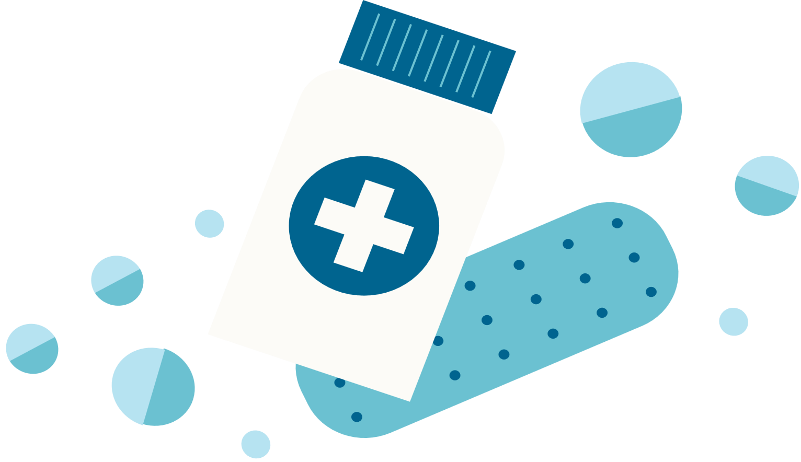

USER
Make appointment
SelfAssessment
Sign up/login
View therapist
Sos Features
Technology Stack
Frontend : React ,TailwindCss
Backend : Java Spring Boot
Database : MongoDB
Frontend : React , TailwindCss
Blog
Submit appointment, self assessment , Sos , Blog
API Calls
Backend : java spring Boot
Database queries
Send notification
Database : Mongodb
Mail Service

Slide 4

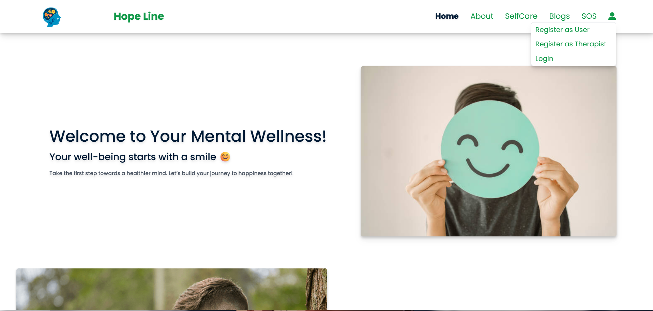


User Authentication and registration:

Slide 5


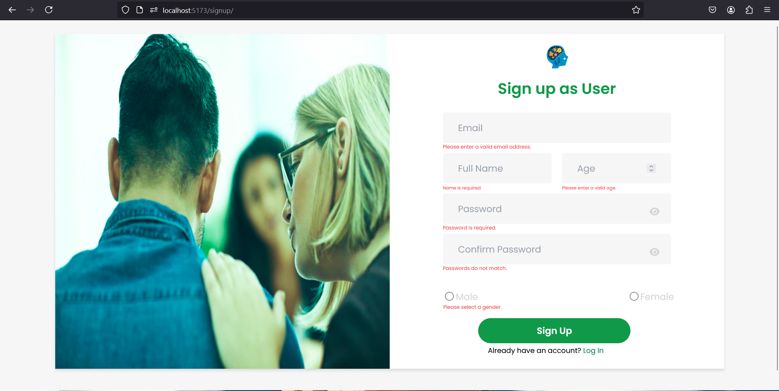
User registration Page:

Slide 6
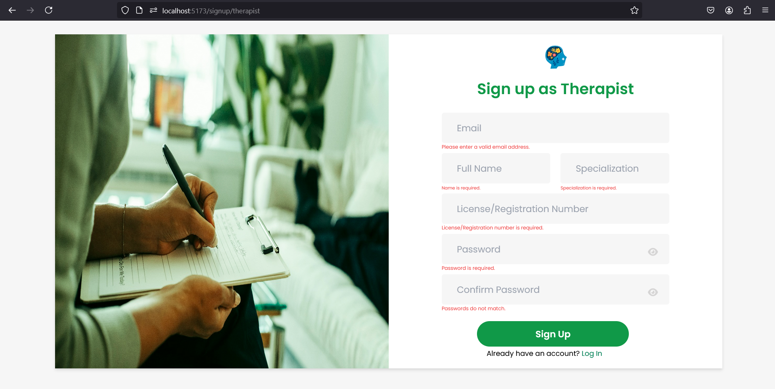
Therapist registration Page:

Slide 7
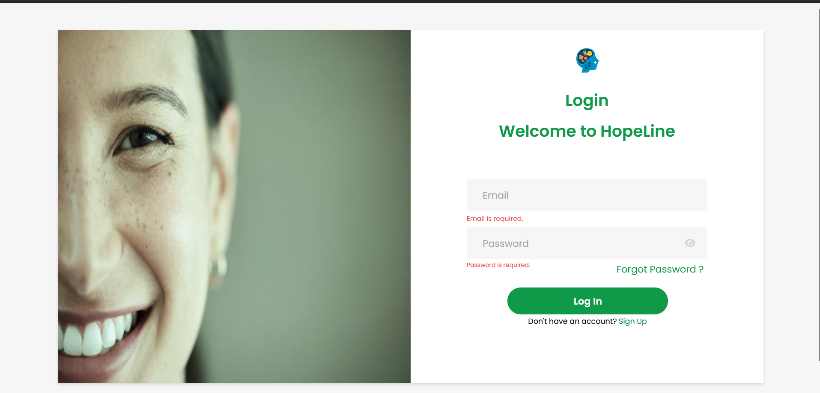
Login Page:

Slide 8

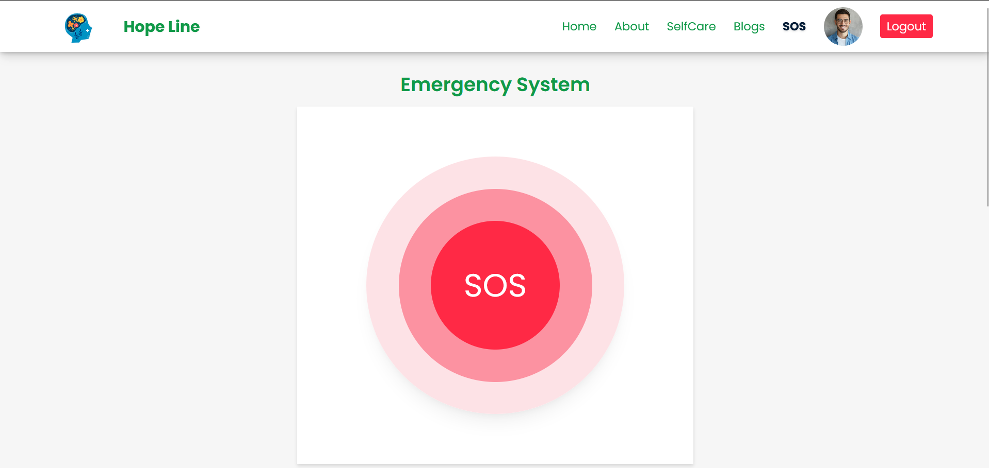
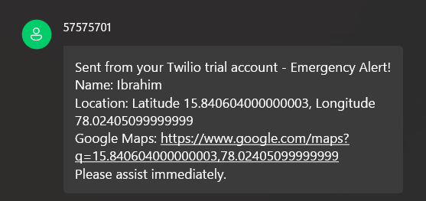

SOS button
SOS Message

Slide 9
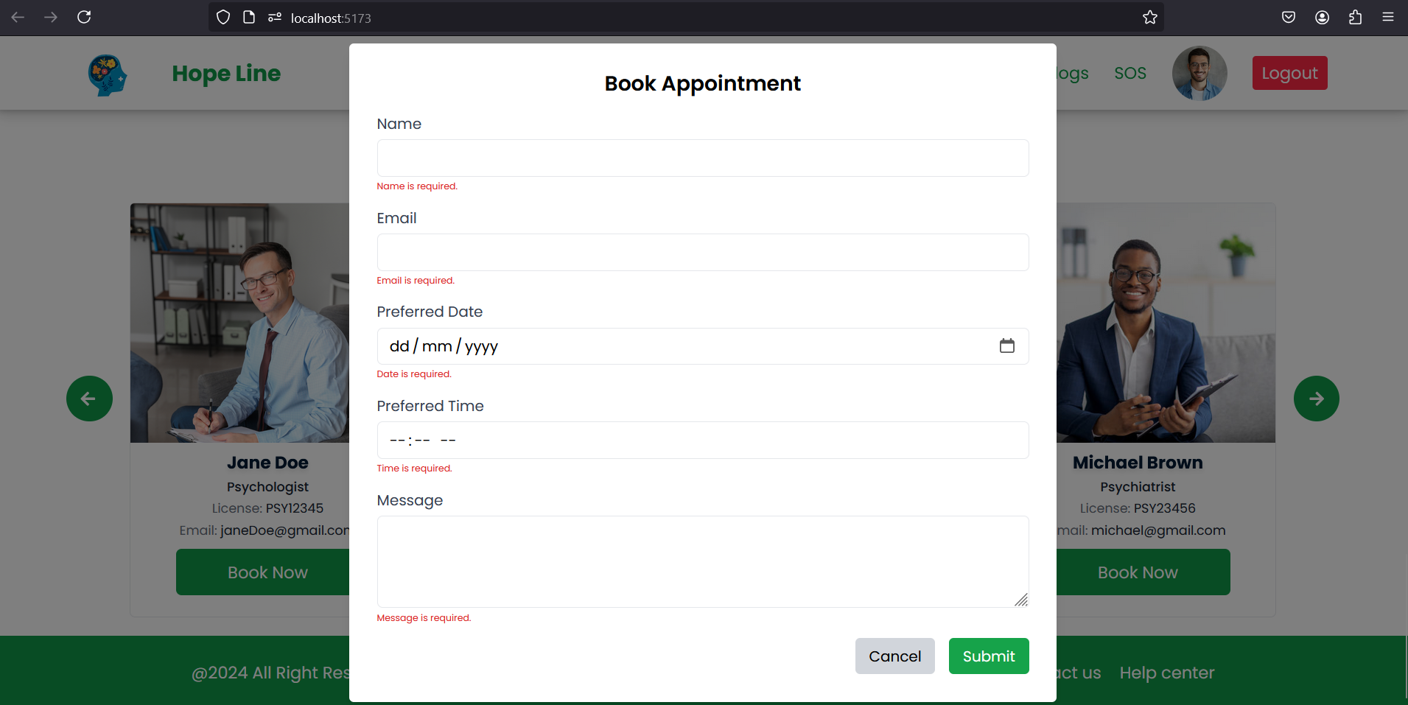
Booking Appointment

Slide 10
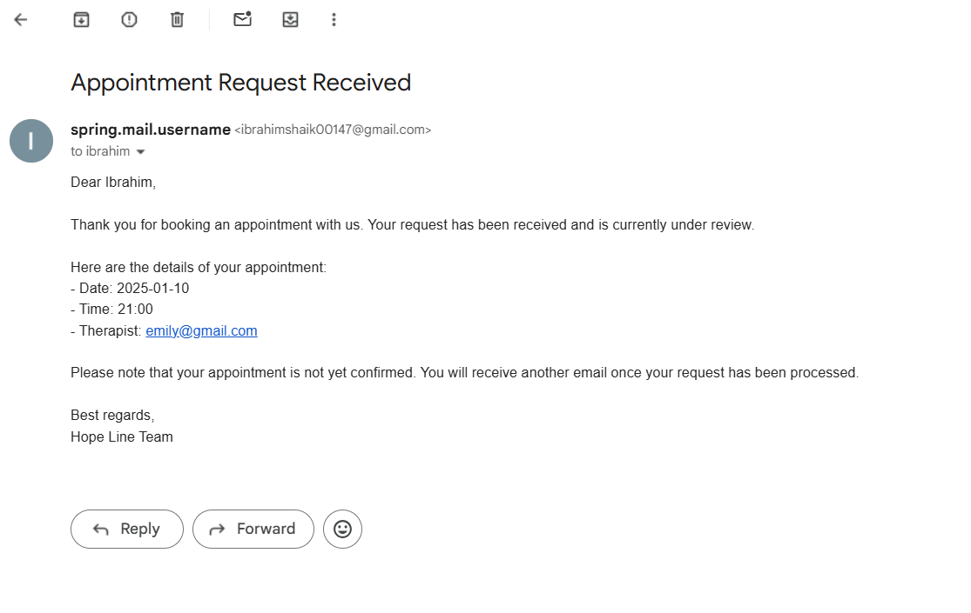

Slide 11


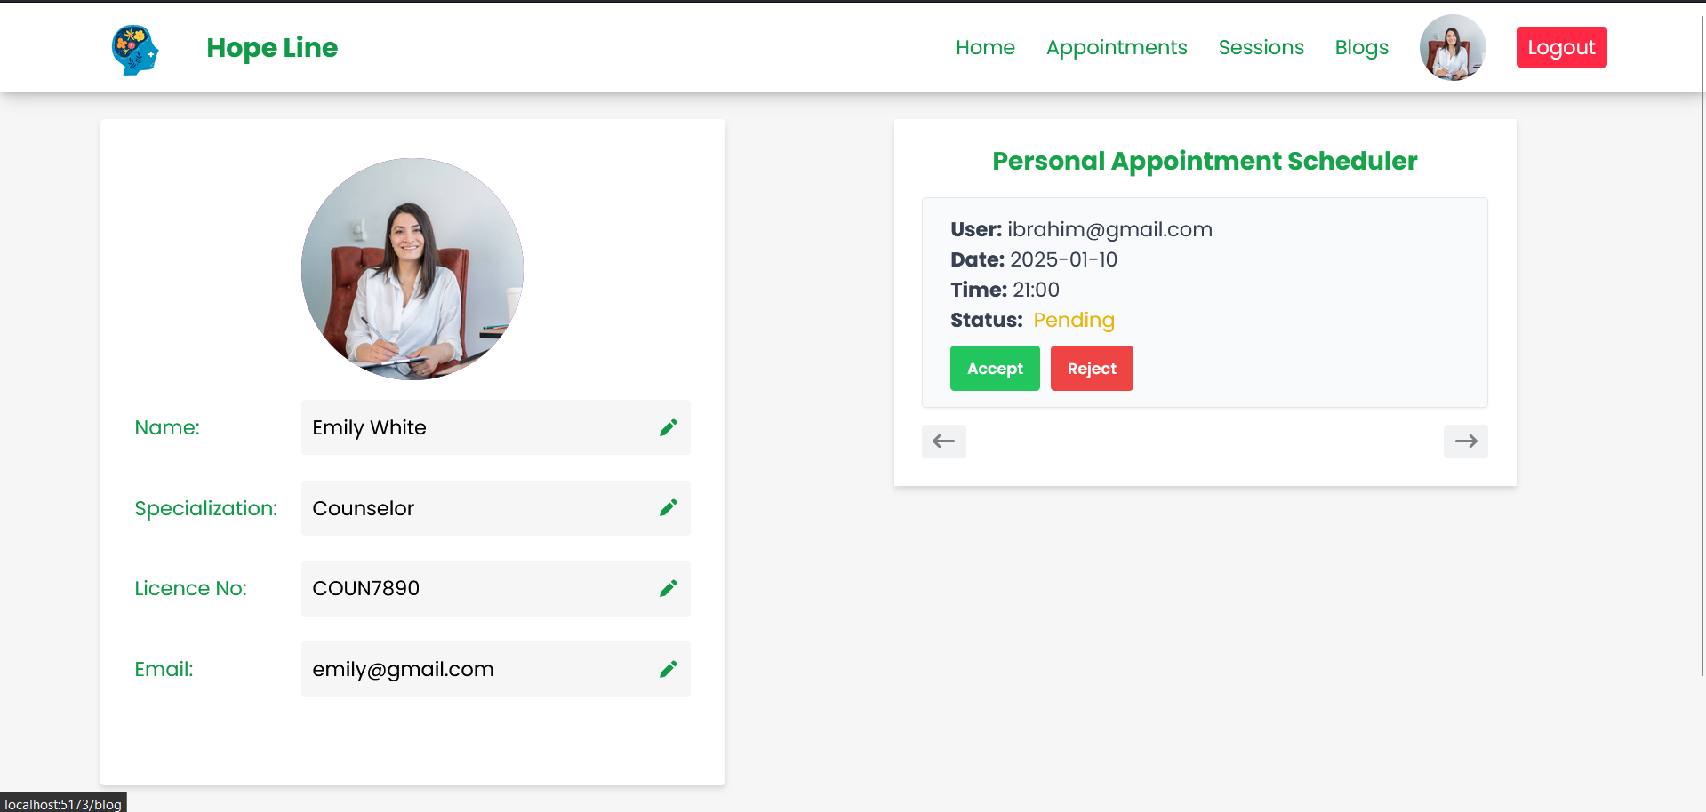
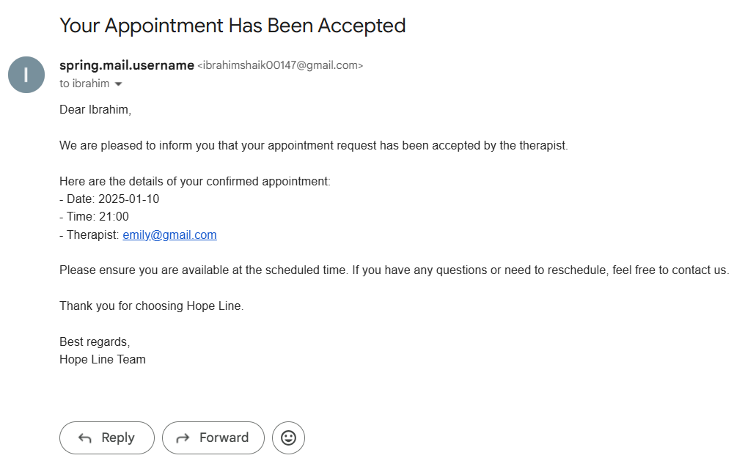


Slide 12
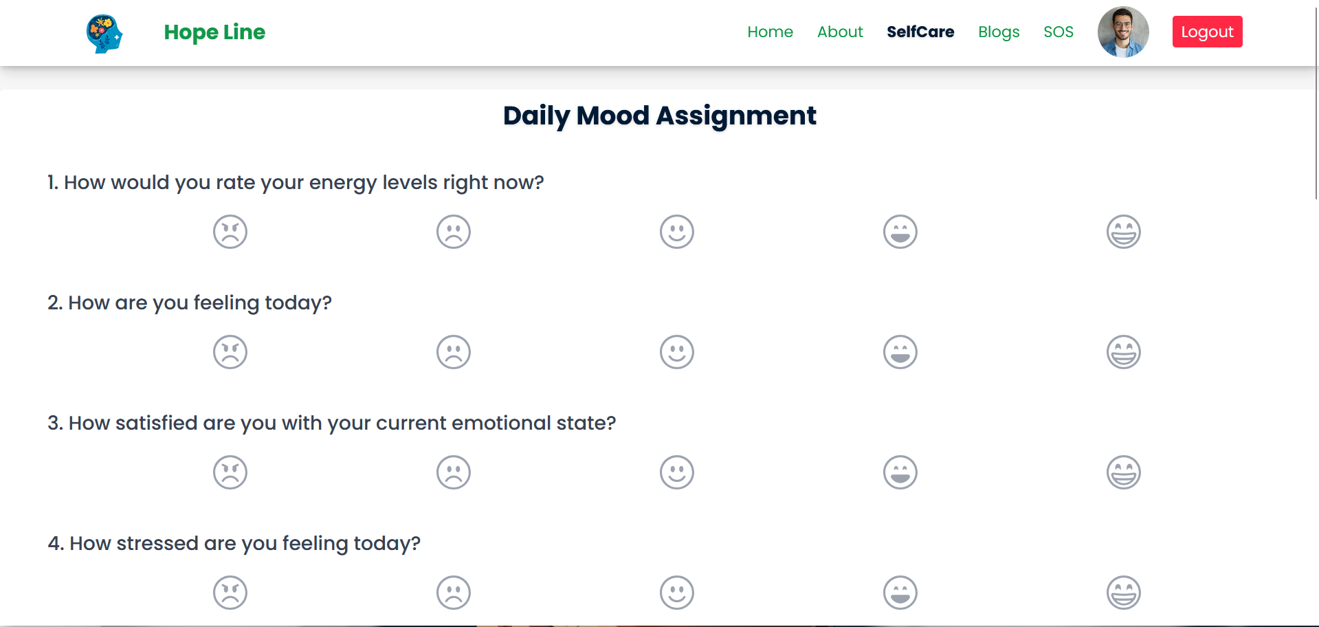
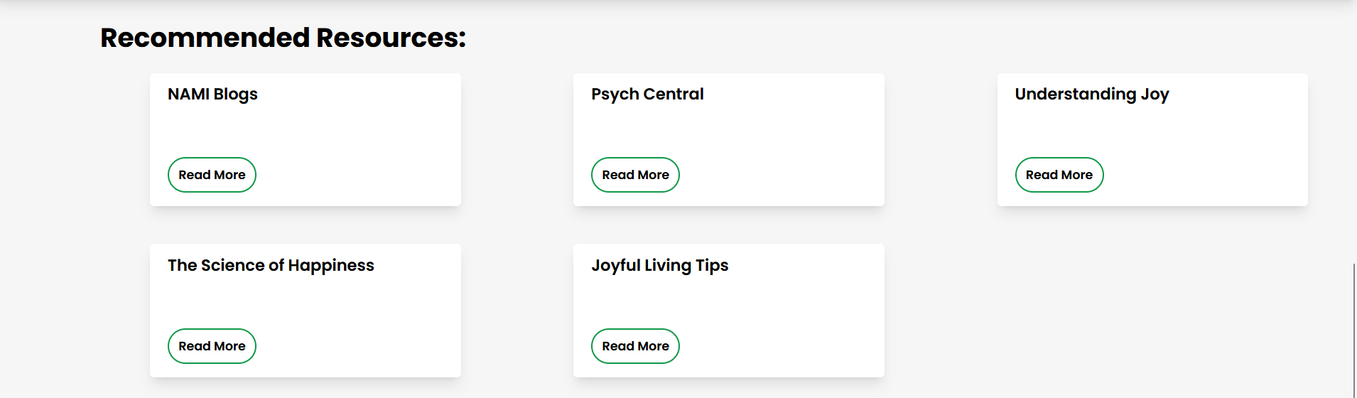
Daily Mood Assignment

Slide 13
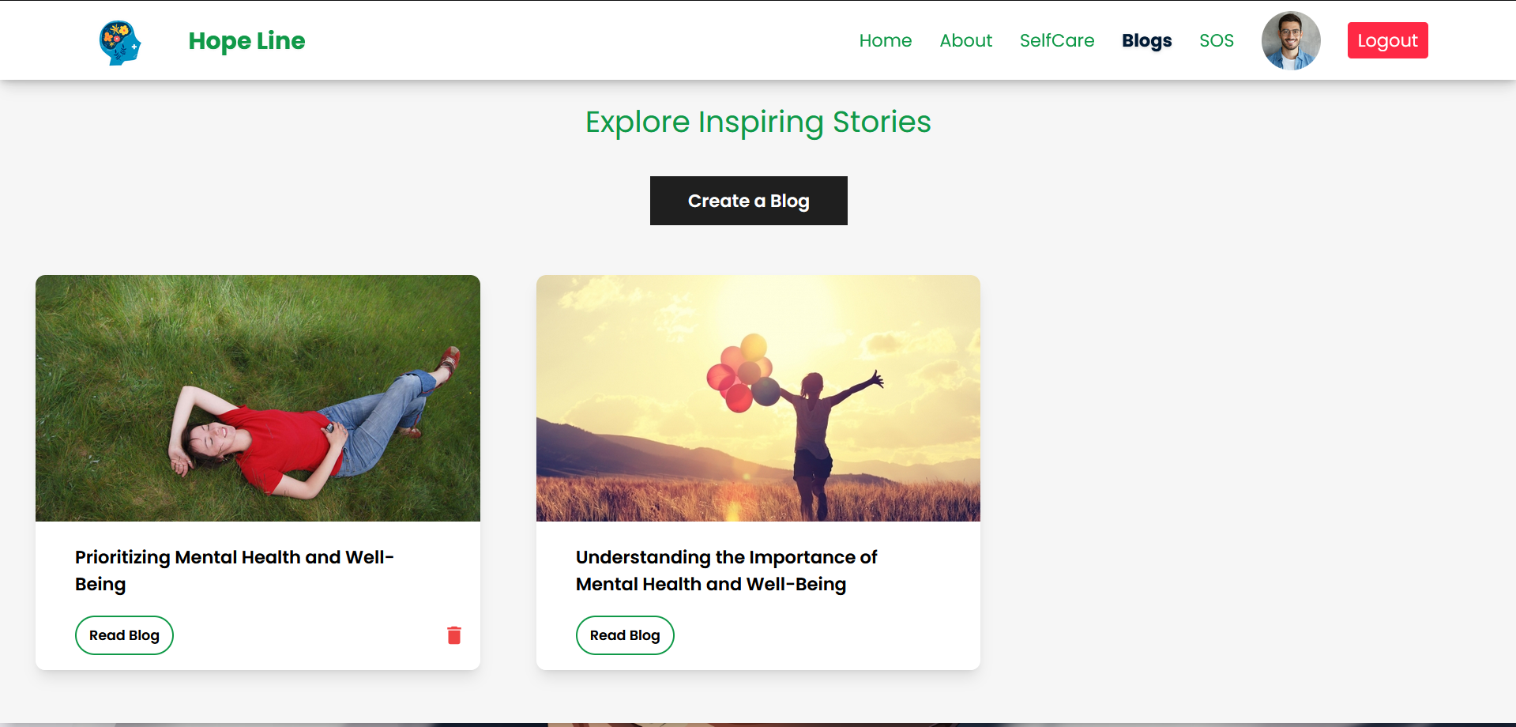
Inspiring Stories Blog

Slide 14



Conclusion :
Comprehensive Mental Health Support
Hope Line provides a holistic platform for mental health care by integrating emergency assistance, personalized mood-based recommendations, and professional therapist consultations, making mental health resources easily accessible to users in need.
Engaging and Supportive Community
With its interactive blog system and role-based features, Hope Line fosters a sense of community by enabling users to share experiences and connect with others, promoting empathy and shared learning.
3. Benefits for All Stakeholders
Users access vital support, therapists manage appointments efficiently, and admins oversee a secure, supportive platform.

Slide 15





THANK
YOU

